Slide 1
Cloud

Slide 2
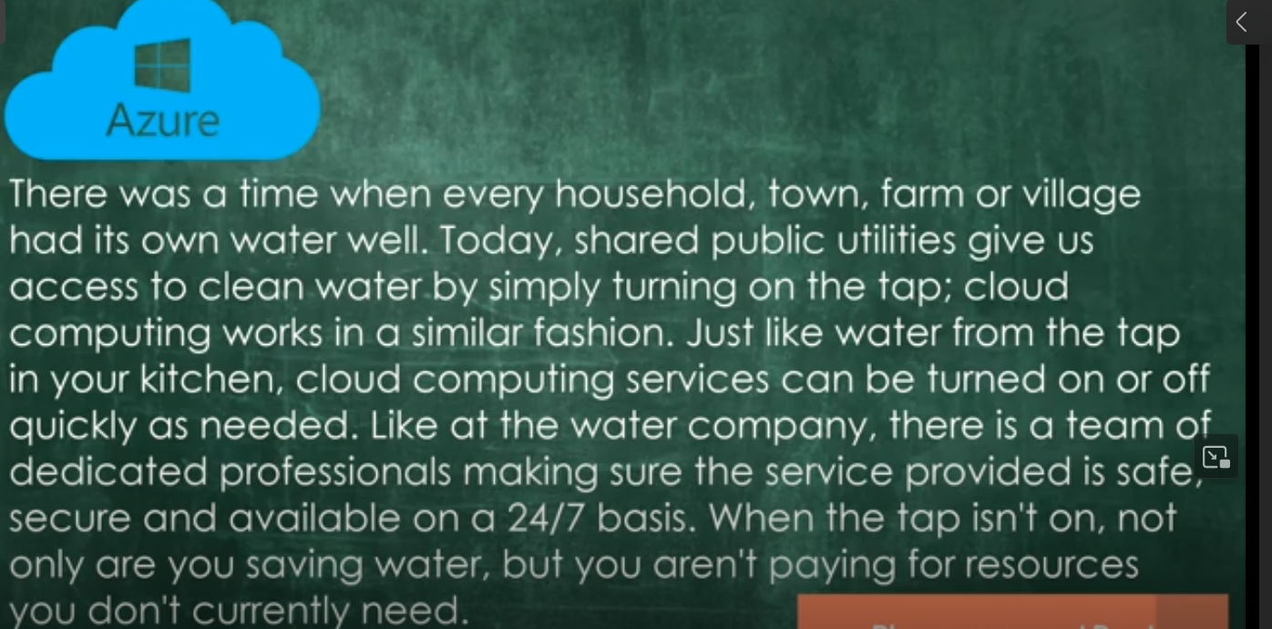
Azure Cloud : Pay as you go model
Capital and operation expenditure comes down

Slide 3
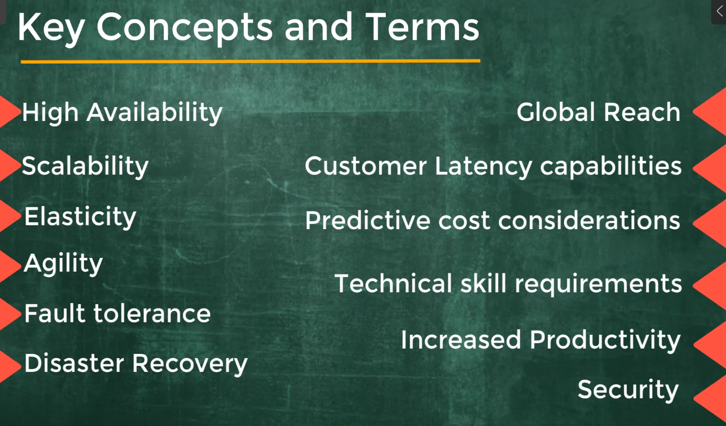
Scalability: How to handle request when user are placing order in e-commerce
Elasticity: Automatically/ allocating and disallocating resources

Slide 4
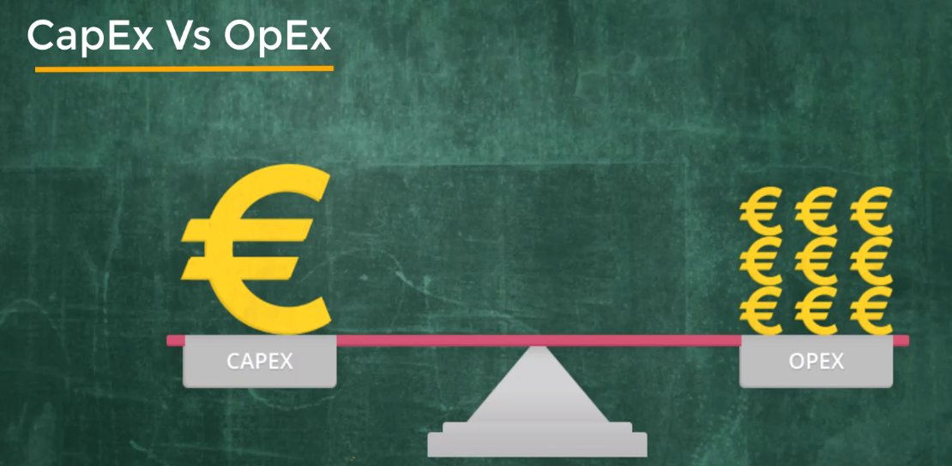
Capex: One time installment cost, hardware, software, internet..
OPEX: Every month maintenance bill

Slide 5
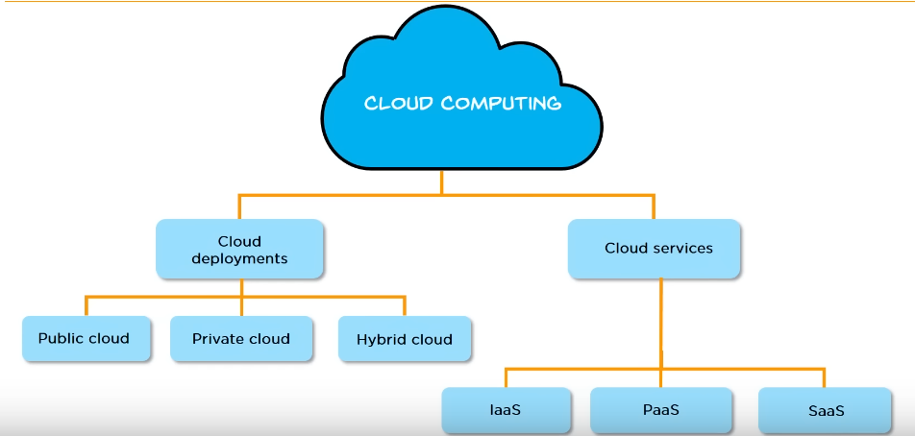

Slide 6
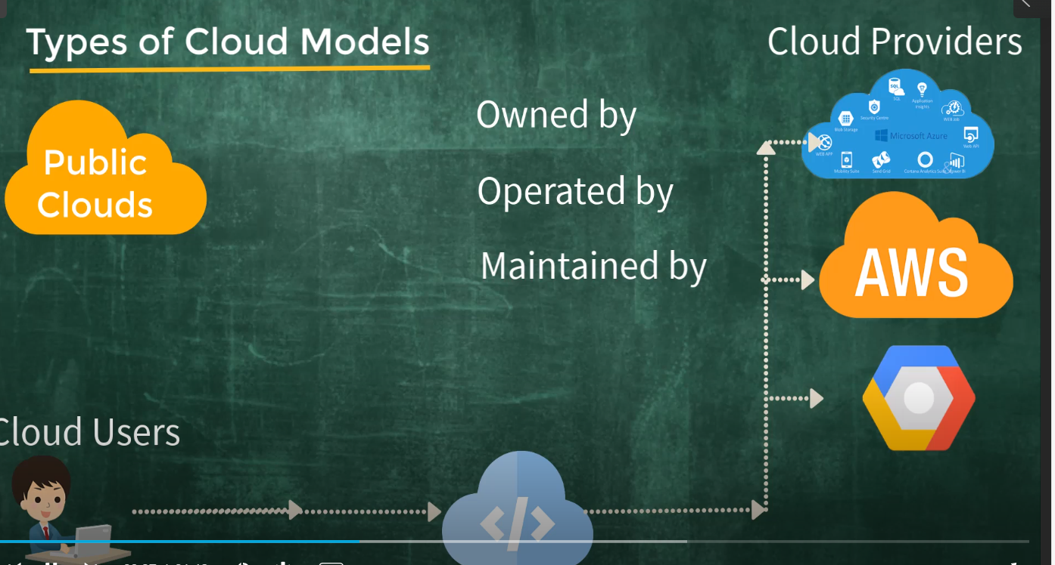
No need to install any hardware

Slide 7
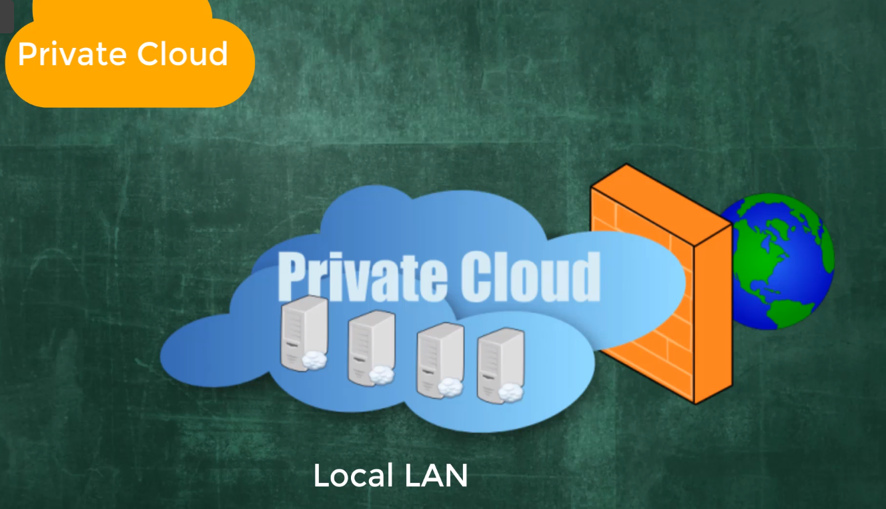
Operated by individual enterprizes
May be some government data, medical data

Slide 8
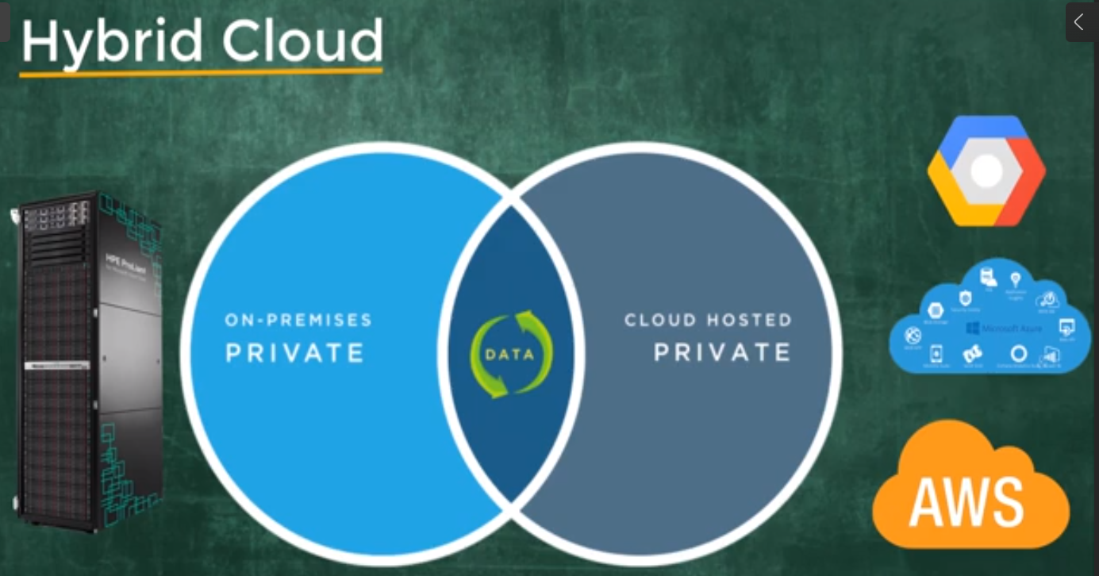

Slide 9
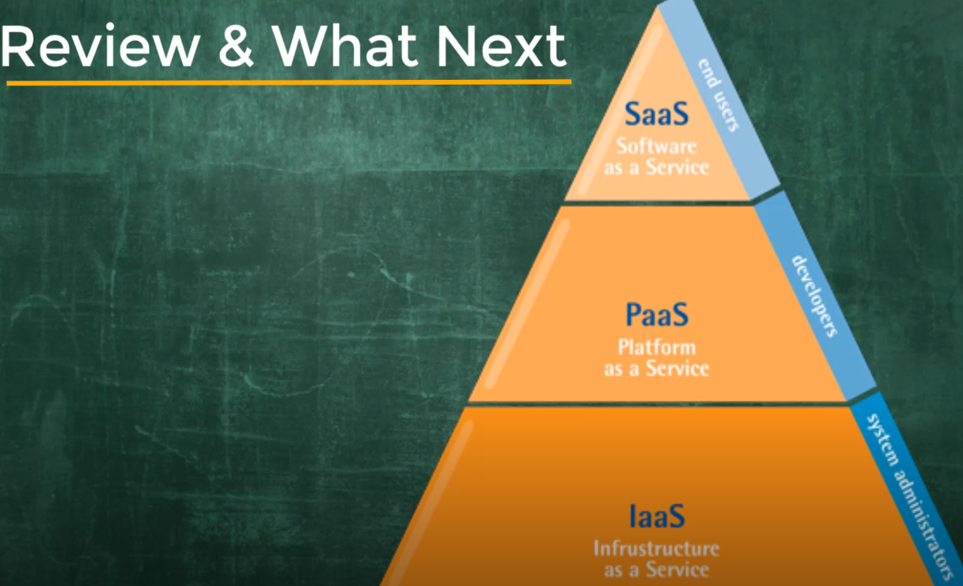
Server, hardware, switches, firewall, underlying wiring … : laaS will be taken care by cloud provider

Slide 10
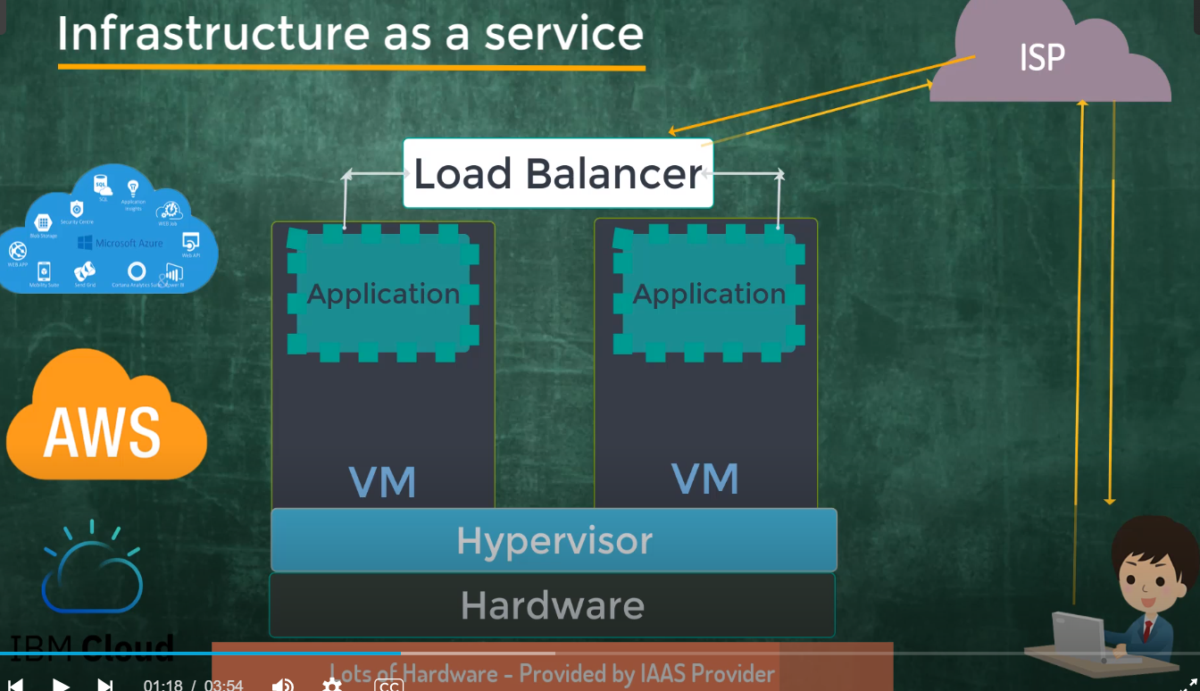

Slide 11
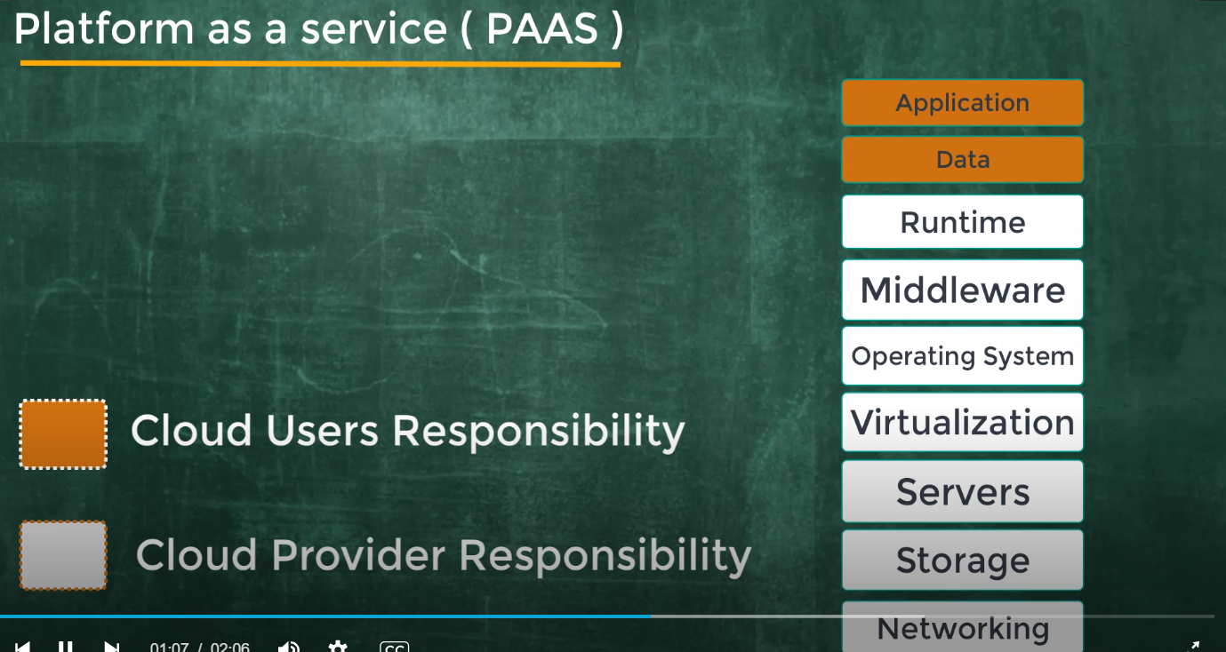
Serverless : DBMS on platform as services, Azure SQL

Slide 12
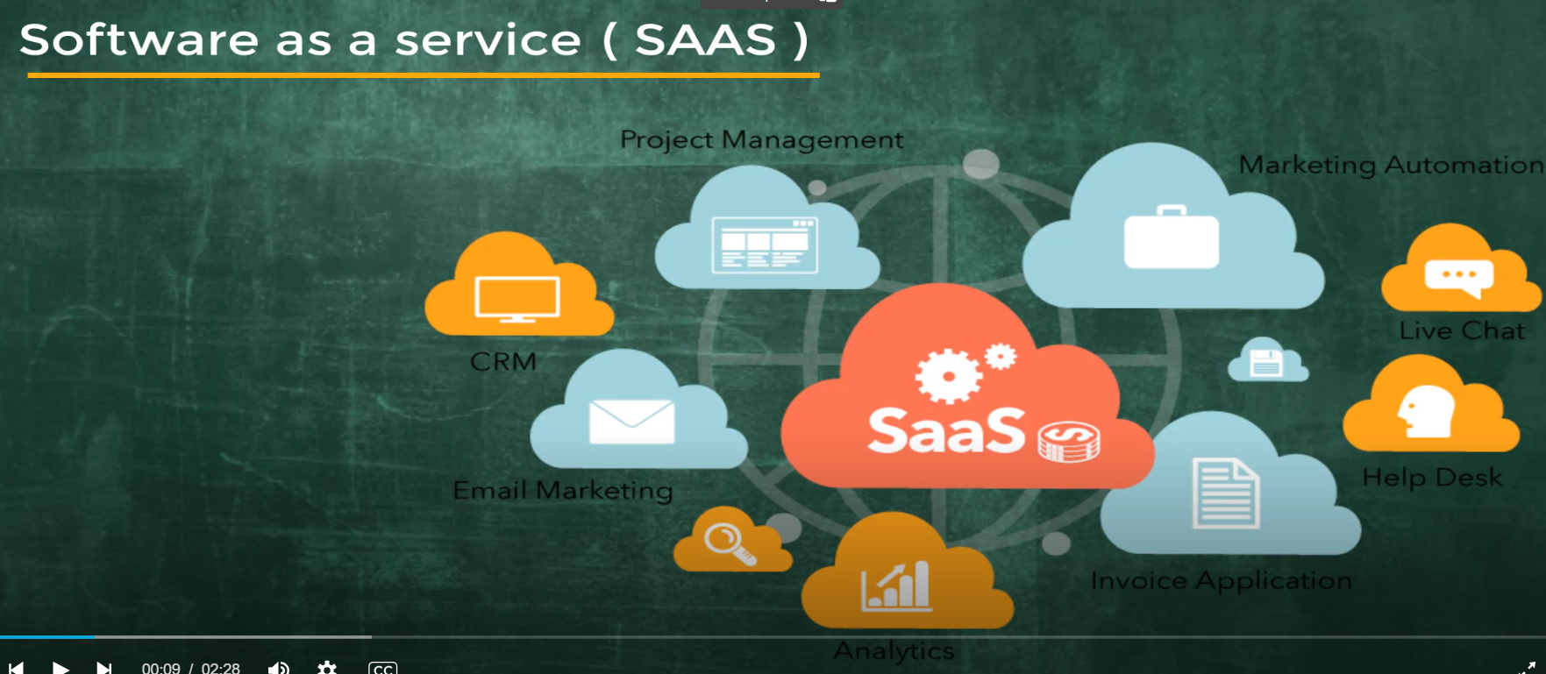
User can access service from anywhere without any installation just using the web browser with internet connection
Outsources most of the IT services
Office 365, Gmail, CRM, Salesforce, facebook, linkedin login and password

Slide 13
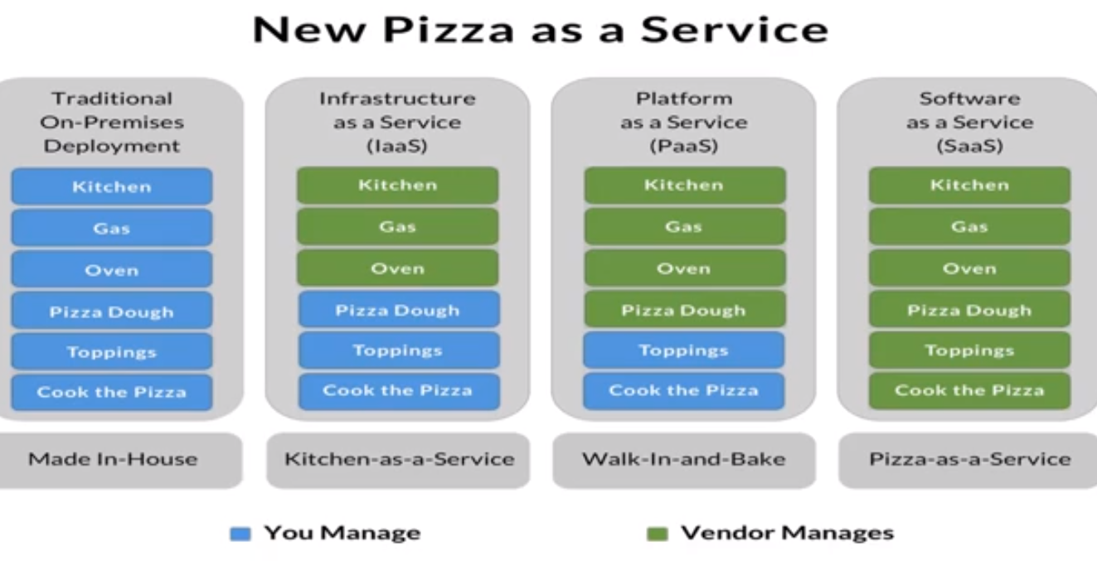

Slide 14
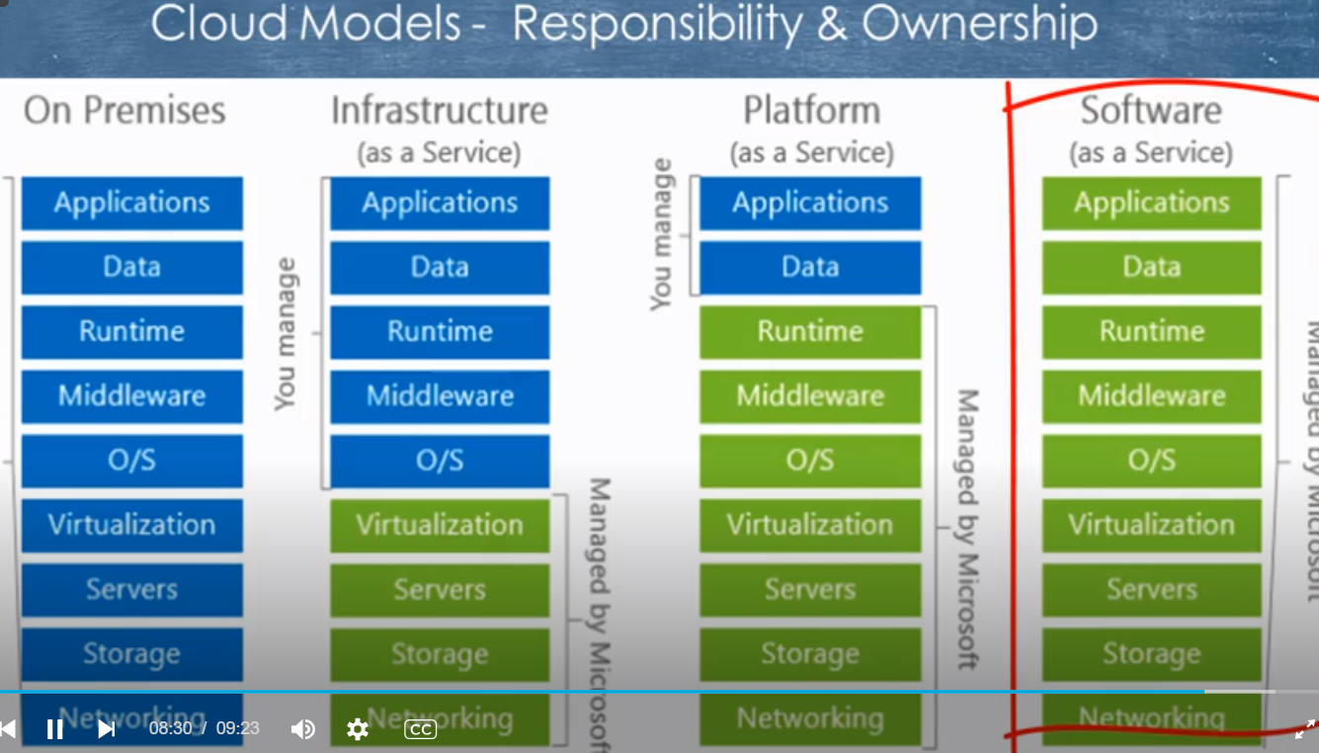

Slide 15
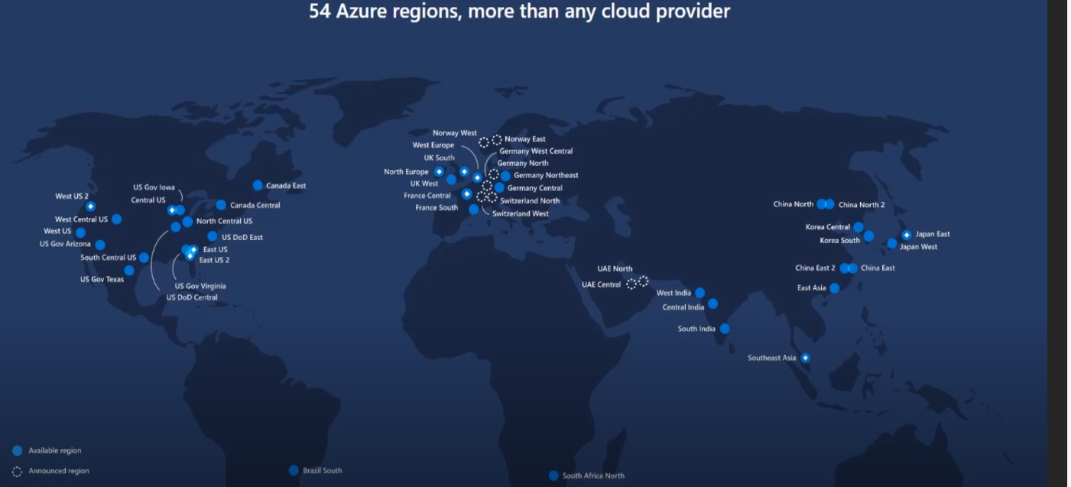

Slide 16
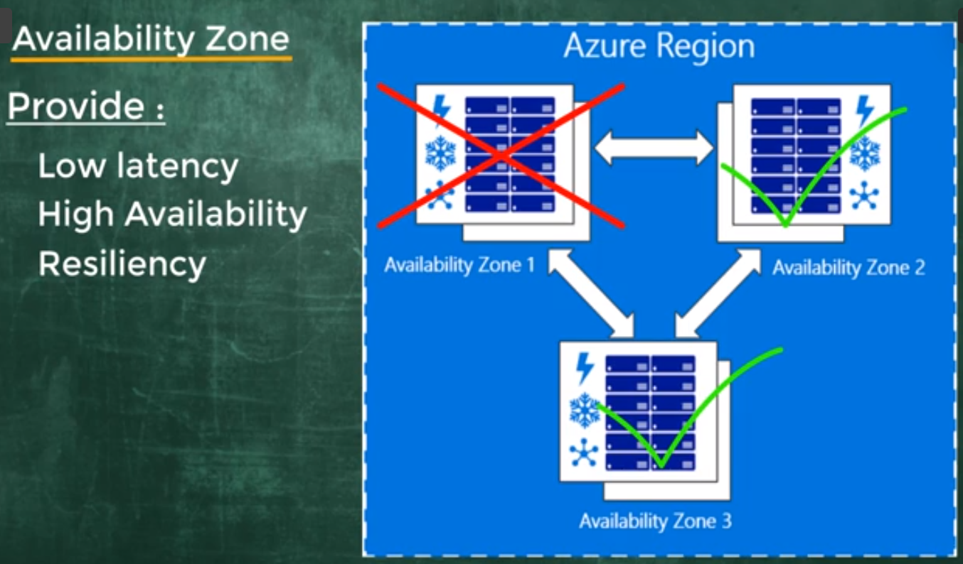

Slide 17
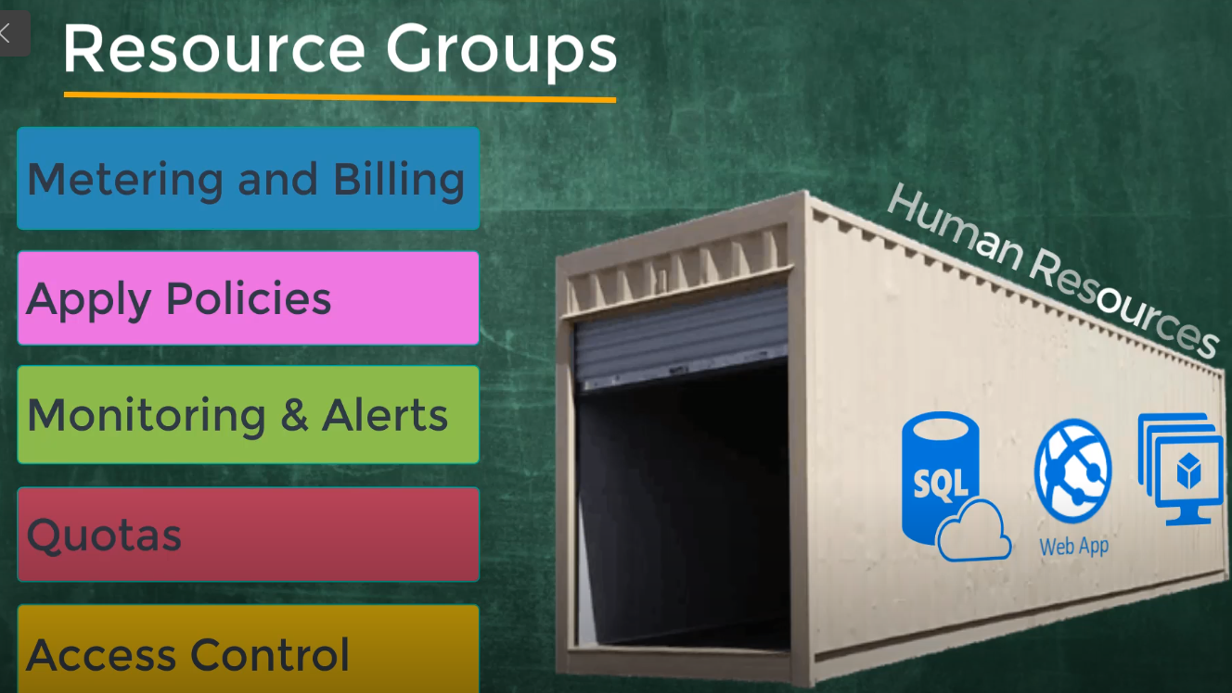
Container for managing all users

Slide 18
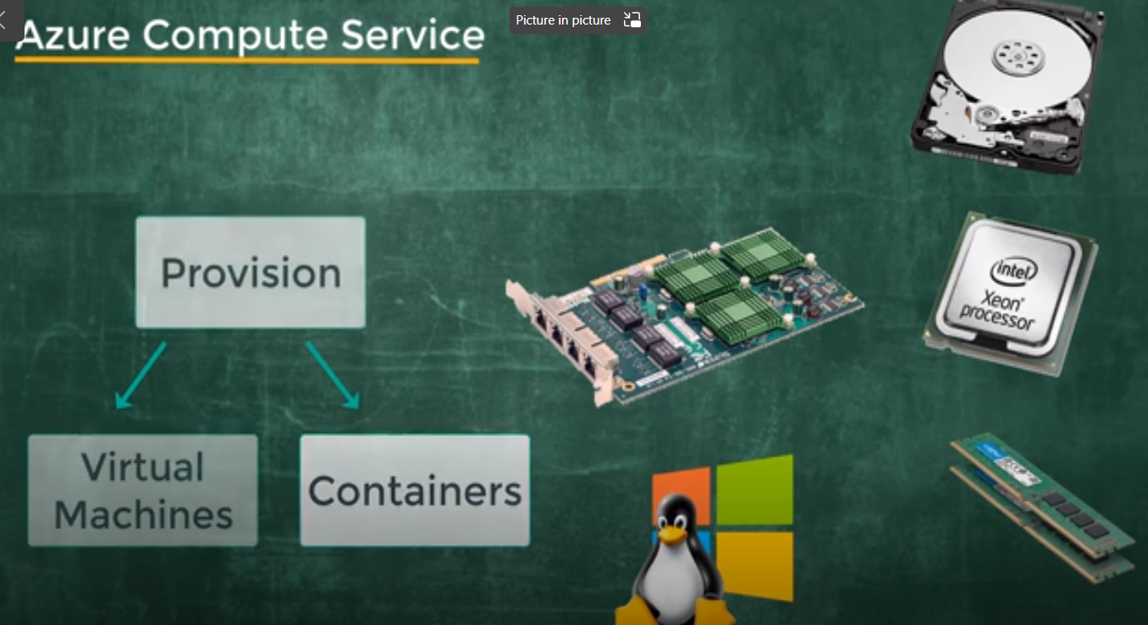

Slide 19
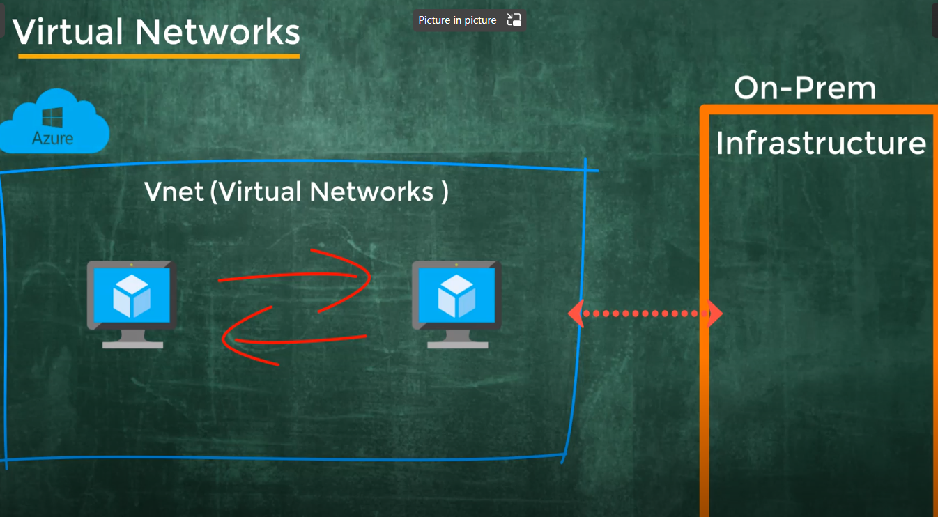

Slide 20
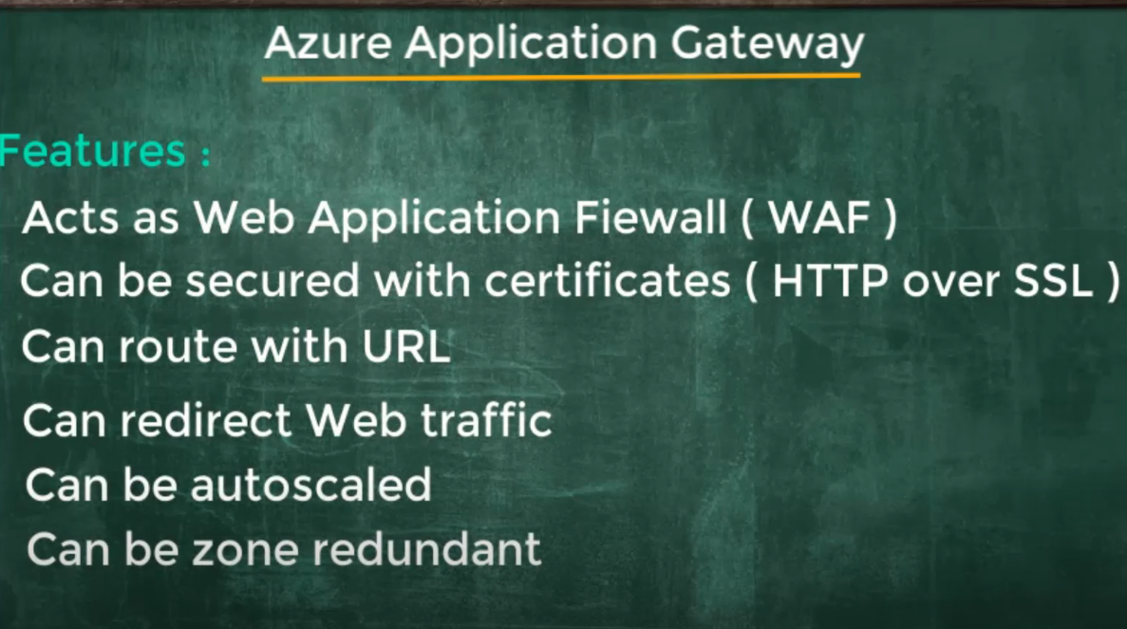

Slide 21
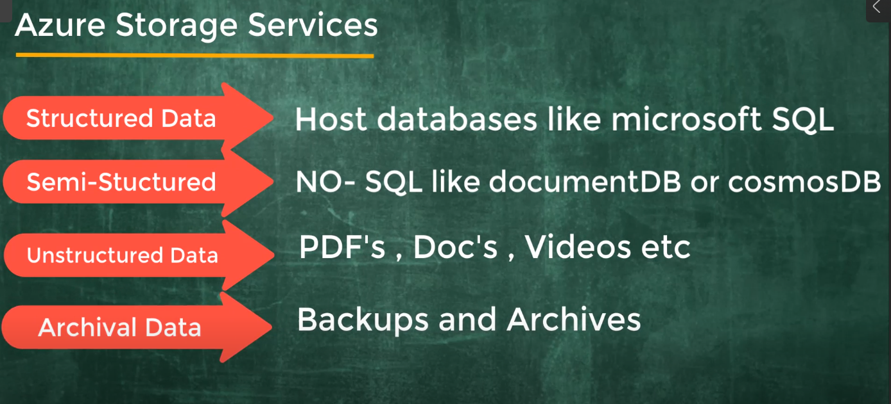

Slide 22
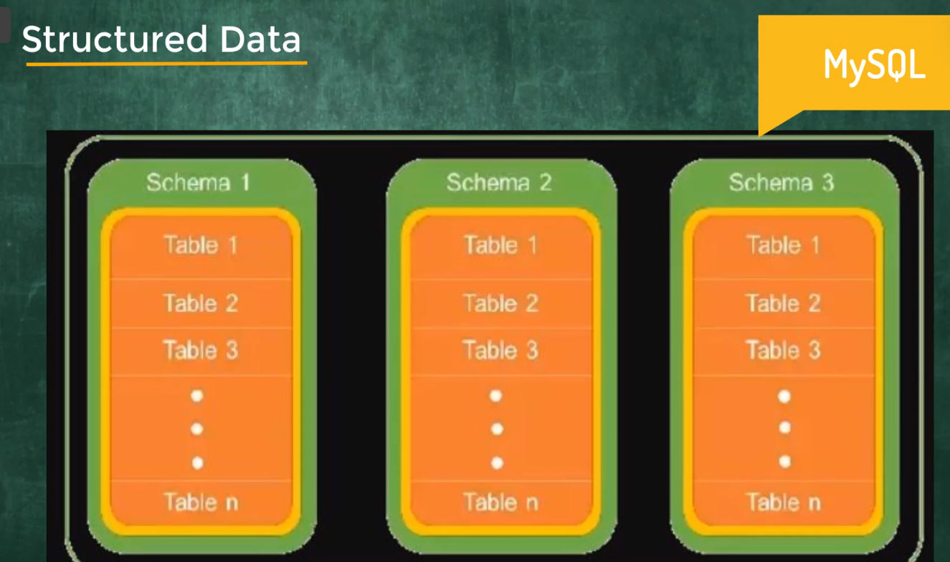
Relational data, defined length and row format, key , clearly defined datatypes, rows and columns
SQL, Oracle, Postgress, MySQL

Slide 23
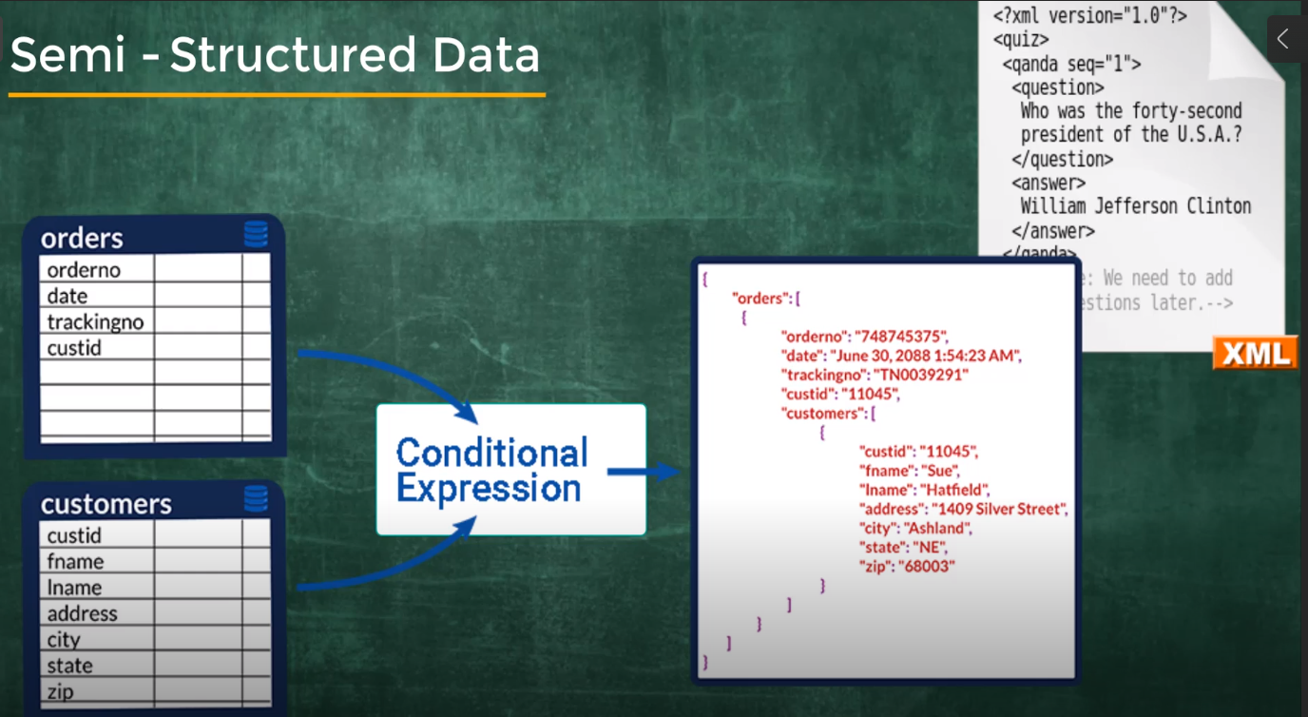
Internal tags, marking, XML, json file, no sql to store the data

Slide 24
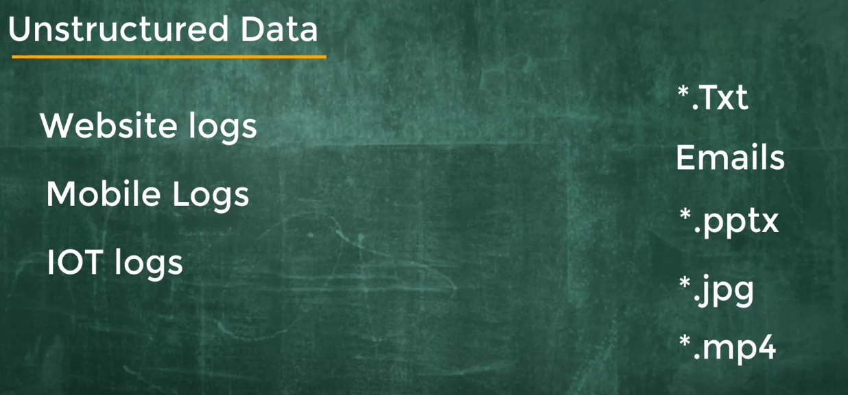

Slide 25
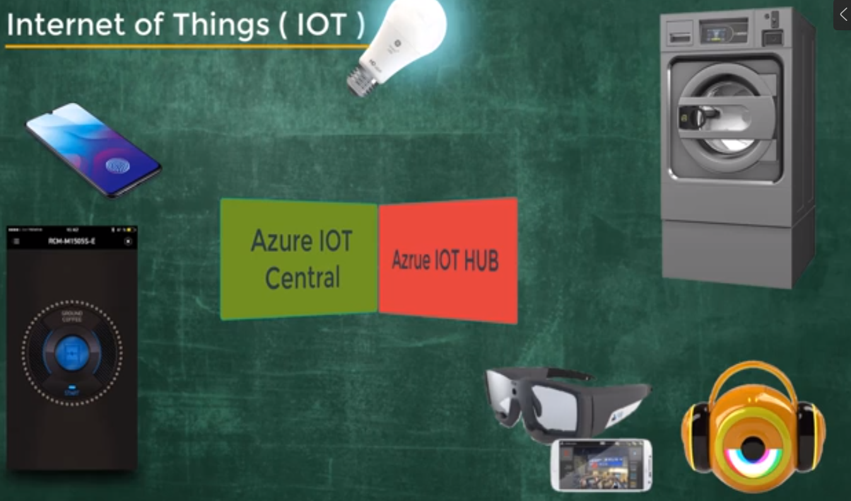
IOT usage is increasing with sensors, and generating lot of data. It is difficult to process for normal computer

Slide 26
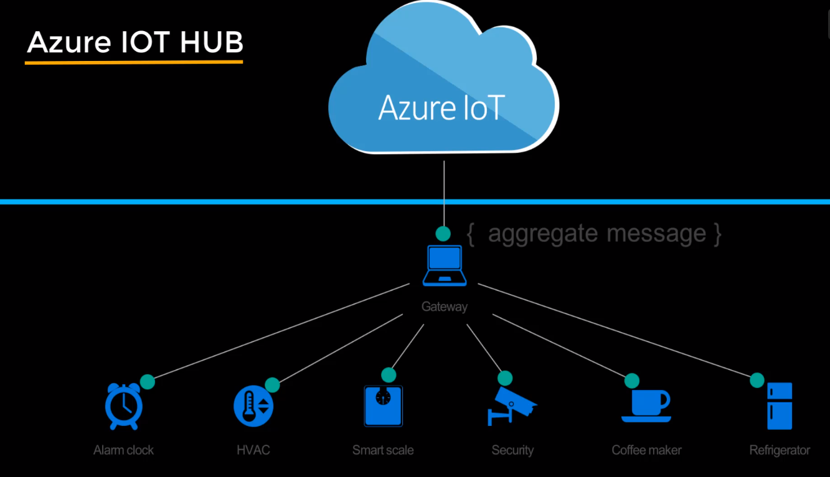
IOT Hub can get, post request , it is bidirectional and take input and generate output. Any machine can be connected virtually.

Slide 27
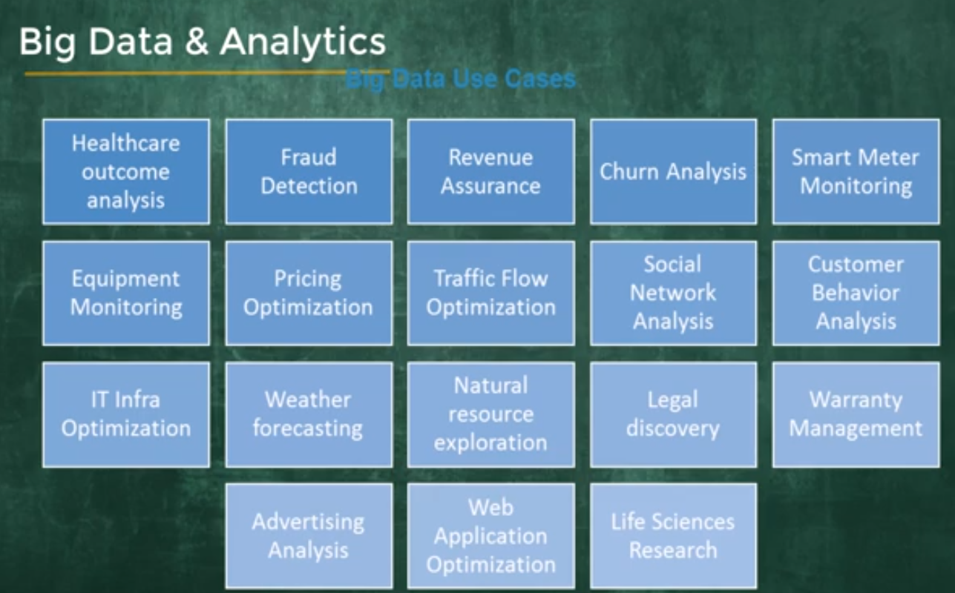

Slide 28
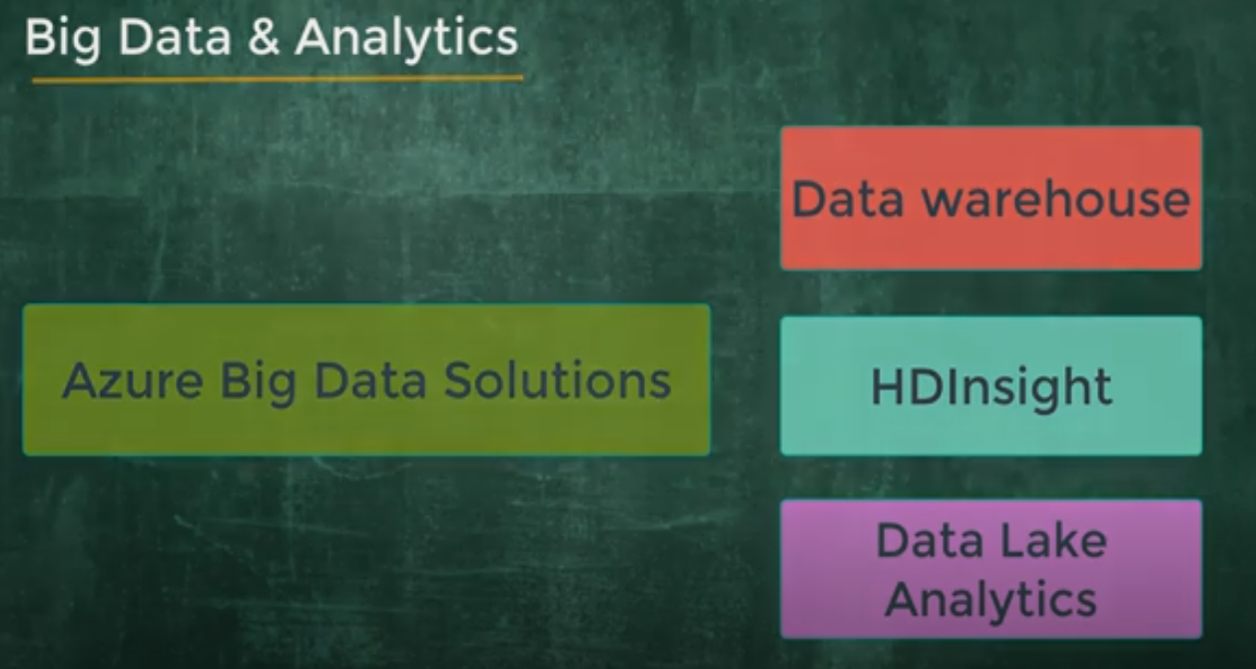

Slide 29
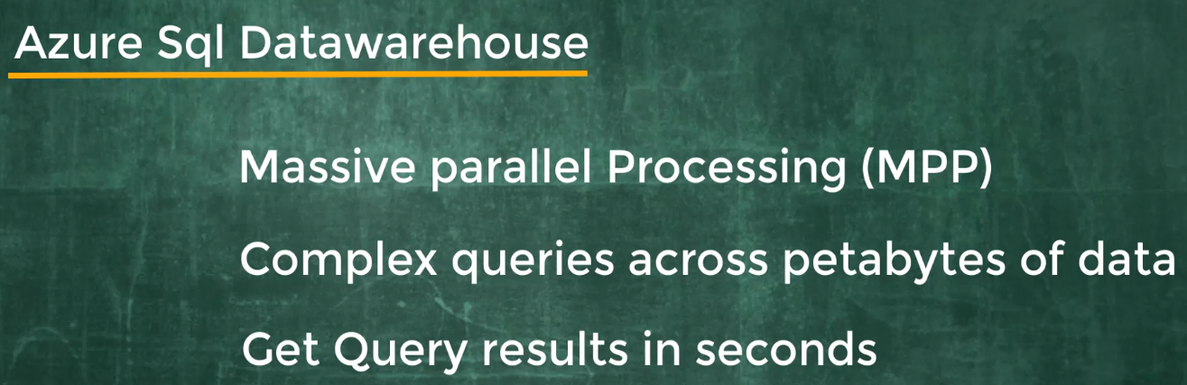

Slide 30
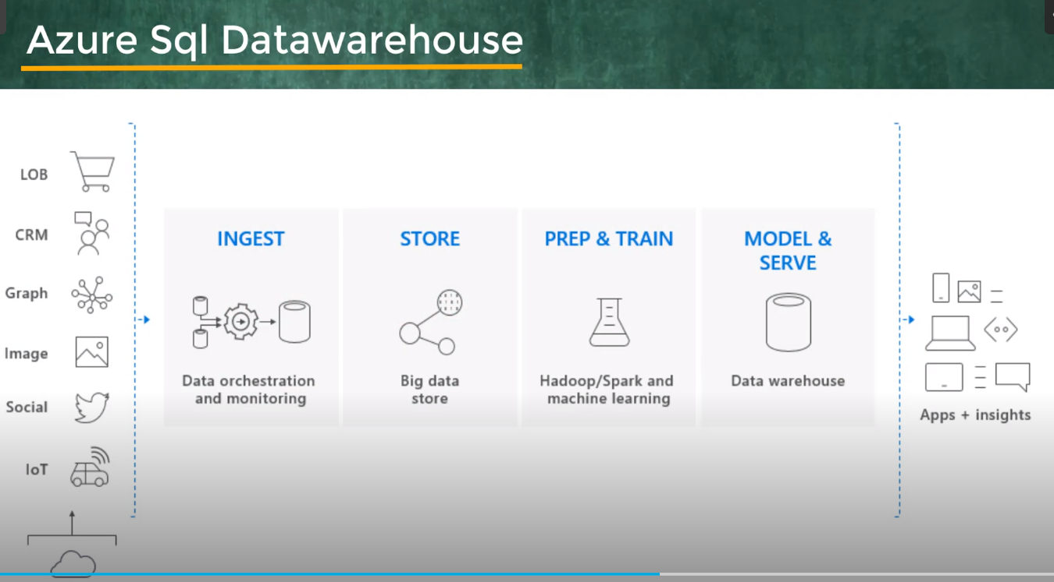
SQL datawarehouse stores data in relational database. Increases the query performance

Slide 31
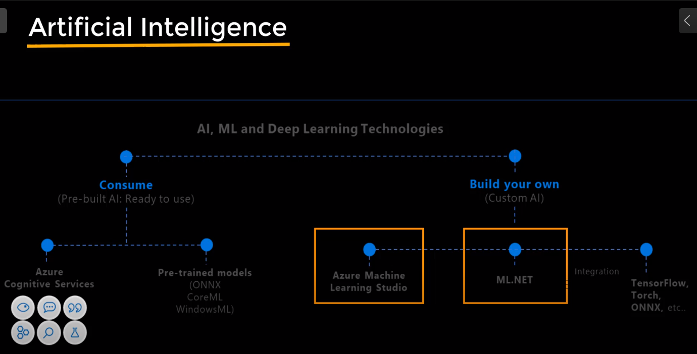

Slide 32
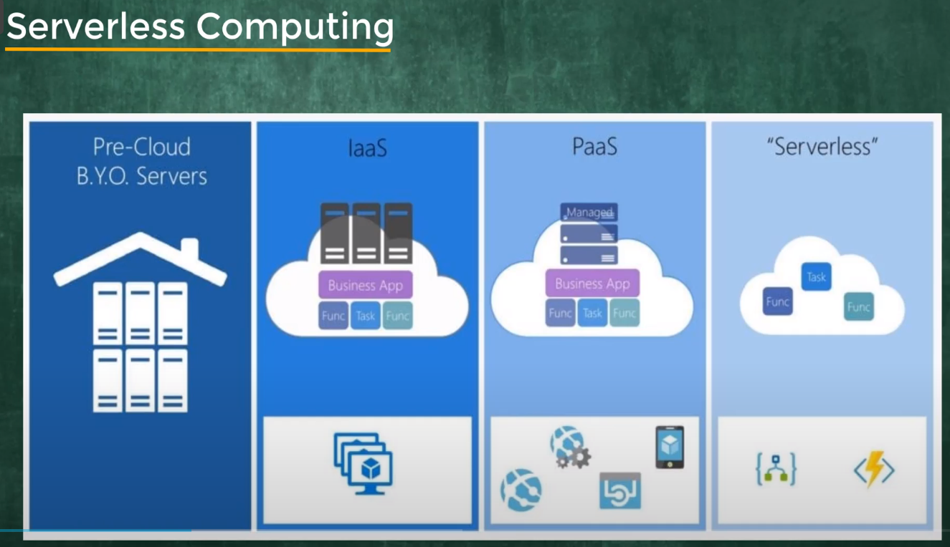
Focus on application/business goals not on the infrastructure.
Cloud providers manages the servers when code is deployed
Azure logic

Slide 33
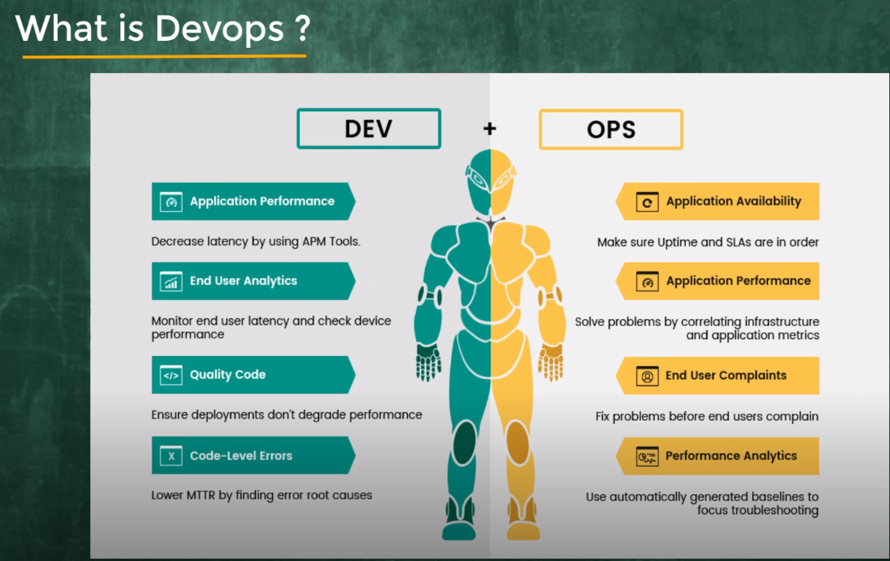
Dev engineer mainly focus on core aspects of application design version controls
OPS engineer to focus on infrastructure

Slide 34
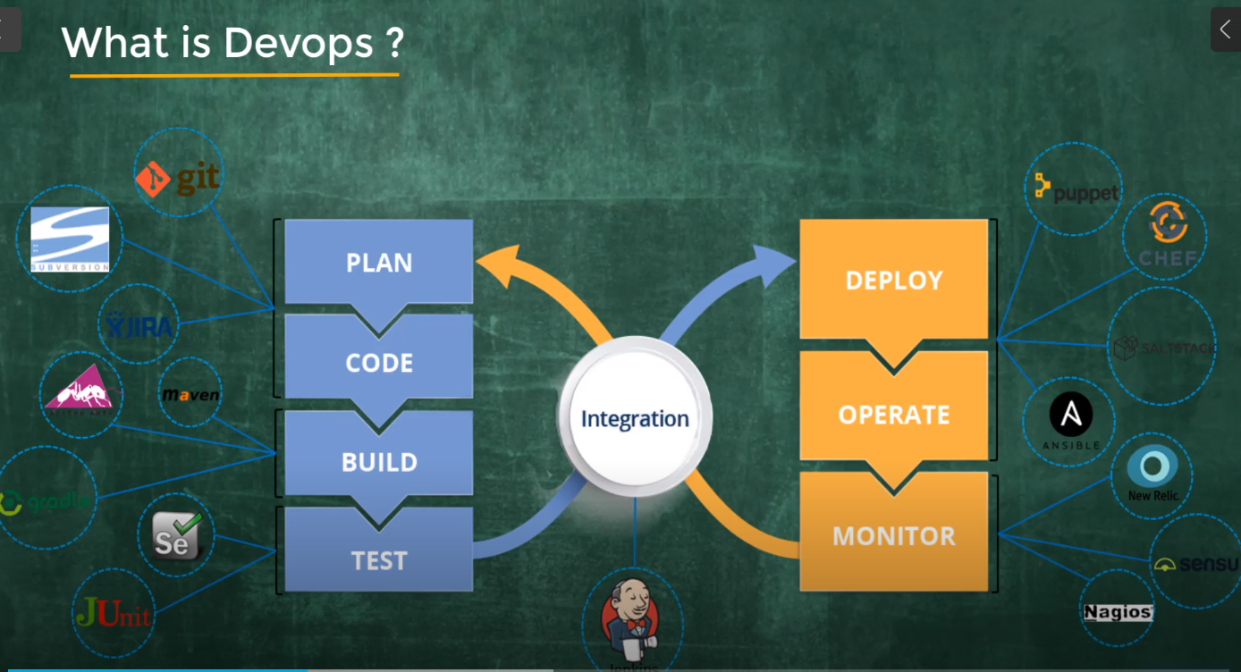

Slide 35
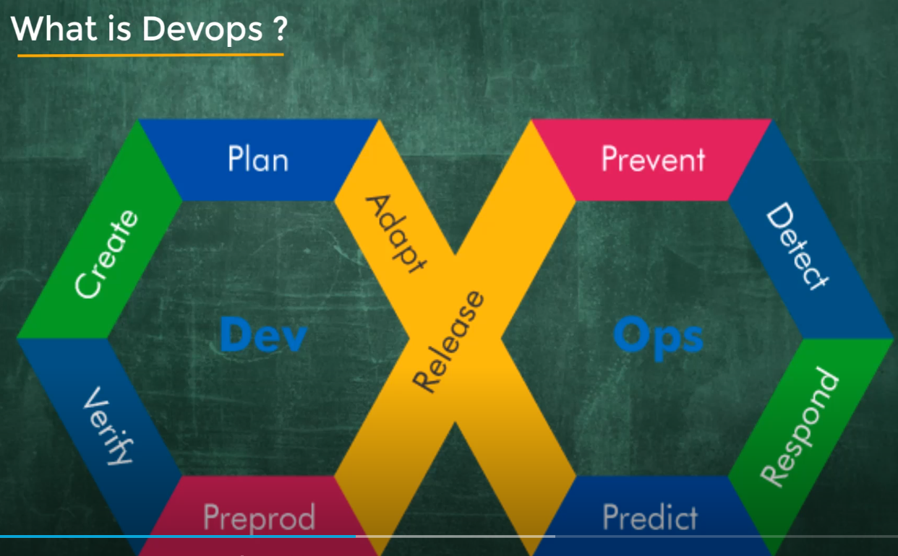

Slide 36
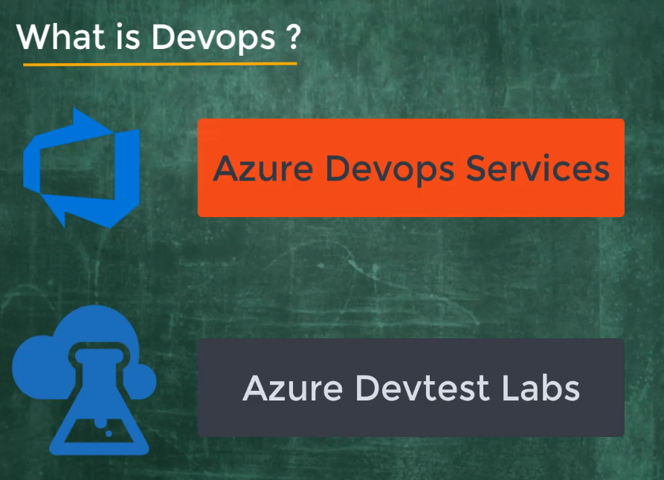

Slide 37
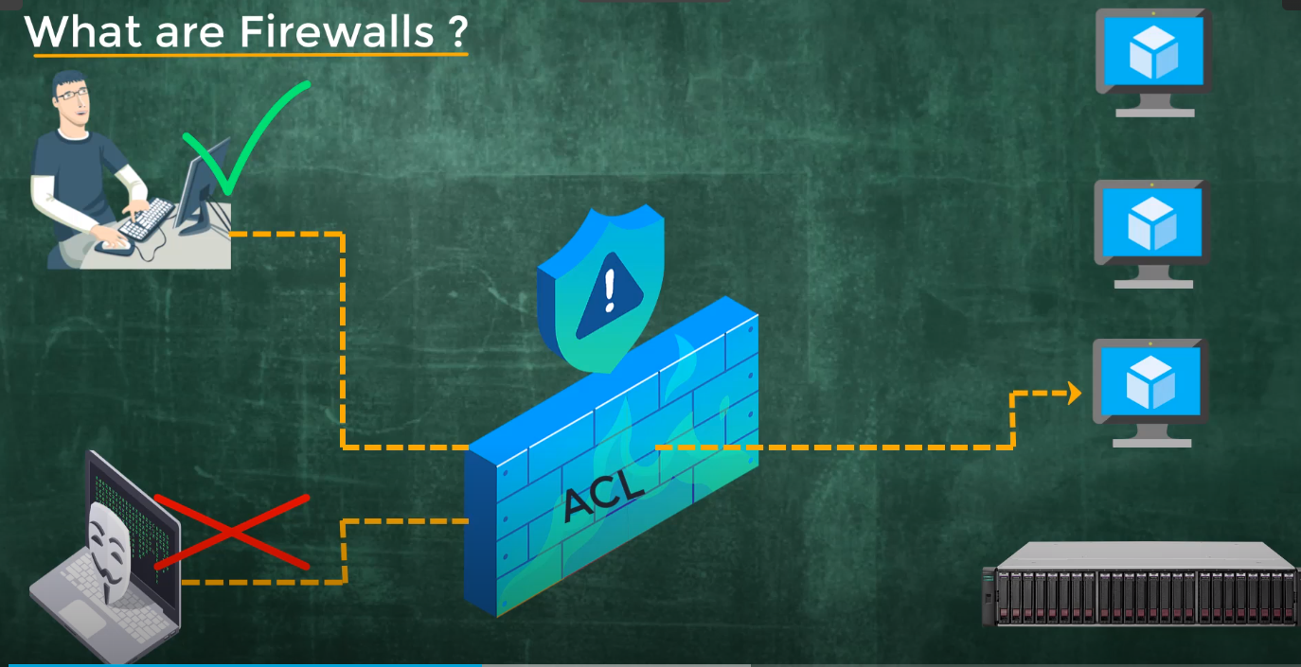

Slide 38
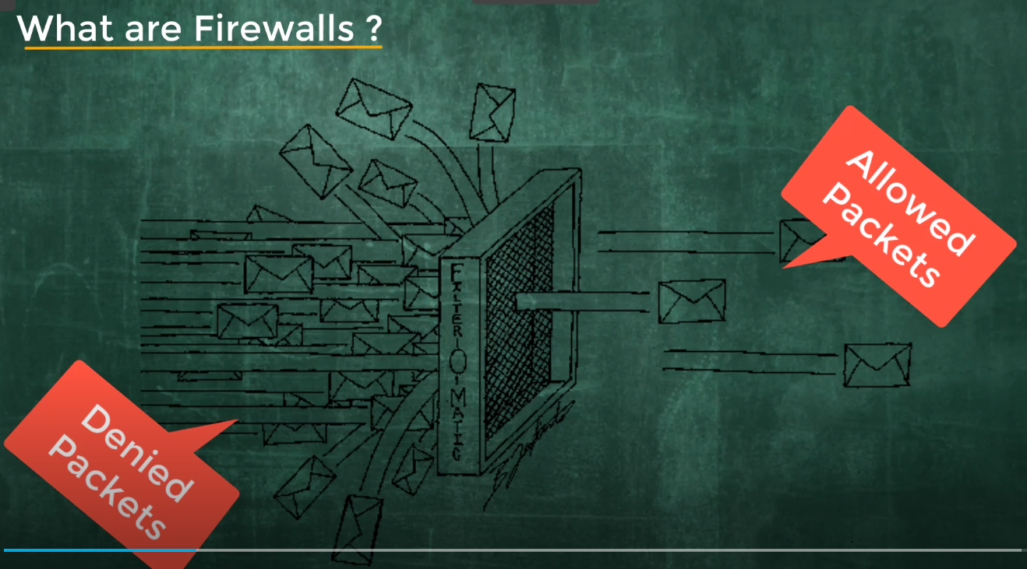

Slide 39
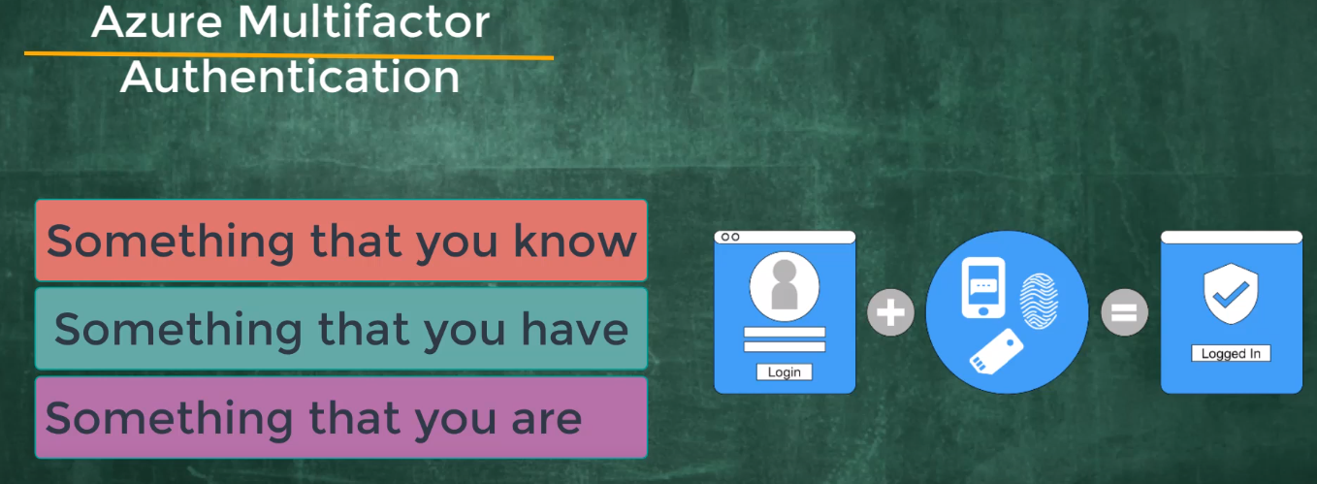

Slide 40
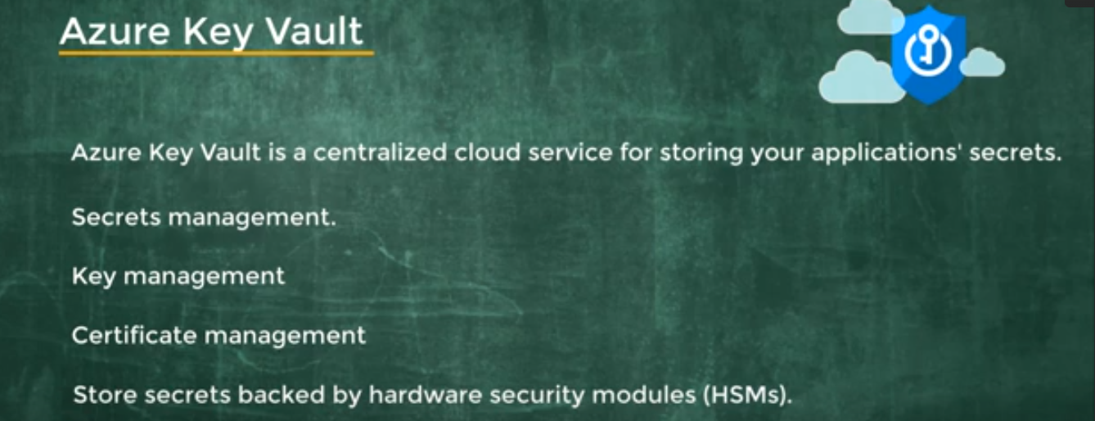

Slide 41
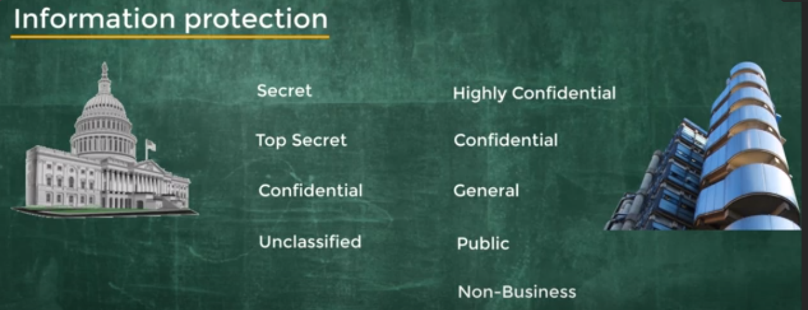

Slide 42
Channel | Link | Topic
Youtube – Simplilearn | https://www.youtube.com/watch?v=M988_fsOSWo https://www.youtube.com/watch?v=RWgW-CgdIk0 | What is cloud computing?
Udemy | https://www.udemy.com/course/az900-azure/ | Basics entry level
YouTube – Edureka | https://www.youtube.com/watch?v=tDuruX7XSac | Azure Core fundamentals
Microsoft Learning Platform | https://docs.microsoft.com/en-us/learn/paths/az-900-describe-cloud-concepts/ | Step-by-step guidelines from Microsoft Azure (Includes videos)

Slide 43

Traditional Vs Cloud Computing
On-Prem Servers
Hosted Servers
Cloud Servers
BUY
LEASE
Pay what you use

Slide 44
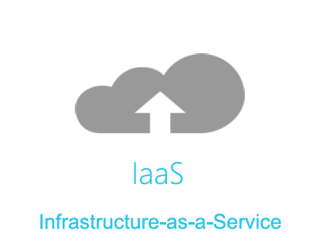
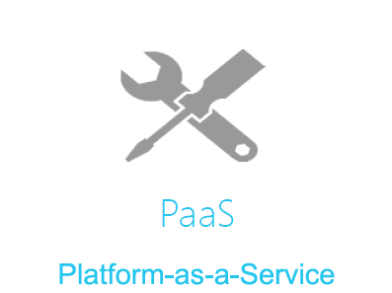
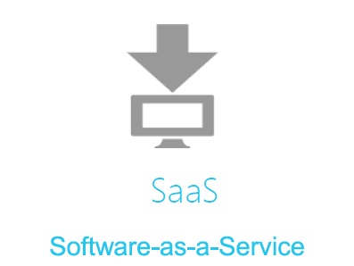
Cloud Computing Models
IaaS (Infrastructure as a service)
PaaS (Platform as a service)
SaaS (Software as a service)
Host
Build
Consume

Slide 45
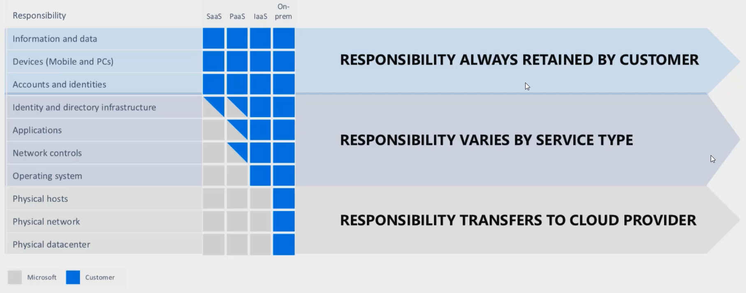
Shared Responsibility Model

Slide 46
What are the advantages of Azure?
Latency significantly reduced: we were able to reduce the latency to < 30 minutes between source and Databricks SQL. Databricks SQL is the replacement for Apache Impala. It is replacement of Impala.
No more delays for data updates due to a busy cluster: each data pipeline has dedicated resources and unaffected by traffic caused by other pipelines or developers/users.
Improved experience for resident developers: resident developers can make use of the Databricks workspace to access your data, work with notebooks and run your jobs
The on-premise cluster is reaching the capacity limits. This won't be the case on the cloud and allow us to develop new features for you.

Slide 47

Databricks Developers

Slide 48
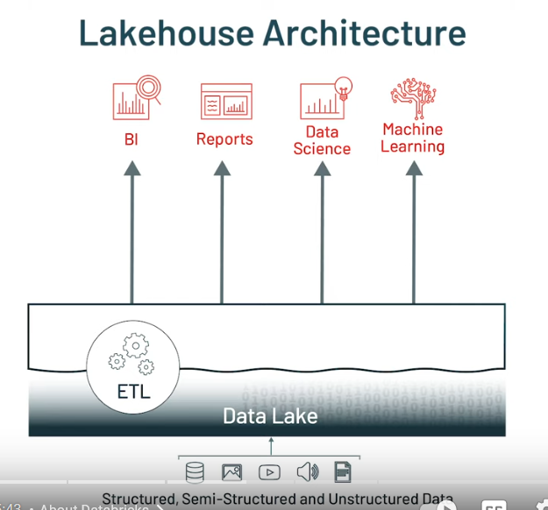

Slide 49
ACID is an acronym that represents a set of properties that ensure reliable processing of database transactions.
Atomicity:
Atomicity ensures that a transaction is treated as a single, indivisible unit of work. It means that all the operations within a transaction are either completed entirely or have no effect at all. There is no in-between state.
If any part of a transaction fails (e.g., due to an error or exception), the entire transaction is rolled back, and any changes made by the transaction are undone, leaving the database in its original state.

Slide 50
Consistency:
Consistency ensures that a transaction brings the database from one consistent state to another consistent state. It enforces integrity constraints, such as unique key constraints or referential integrity constraints.
If a transaction violates any integrity constraints, it is rolled back, and the database remains unchanged.
Isolation:
Isolation guarantees that the execution of one transaction is isolated from the execution of other concurrent transactions. Each transaction is unaware of the existence of other transactions until they are committed.

Slide 51
Durability:
Durability ensures that once a transaction is committed, its effects persist, even in the face of system failures (e.g., power outage or hardware failure). Committed changes are permanently stored in the database and are not lost.

Slide 52
Parquet is an open-source columnar storage file format rather than a row-based format. commonly used in the big data and data warehousing environments. It was designed to optimize data storage and query performance for large datasets. This means that it groups values from the same column together, which can lead to significant compression and performance benefits, especially when querying specific columns.
Parquet is widely used in big data processing frameworks like Apache Hadoop, Apache Spark, and Apache Hive. It's optimized for distributed processing, making it an ideal format for large-scale data analytics.

Slide 53
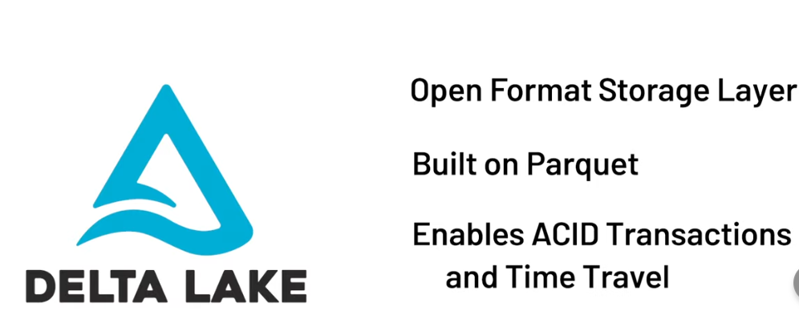

Slide 54
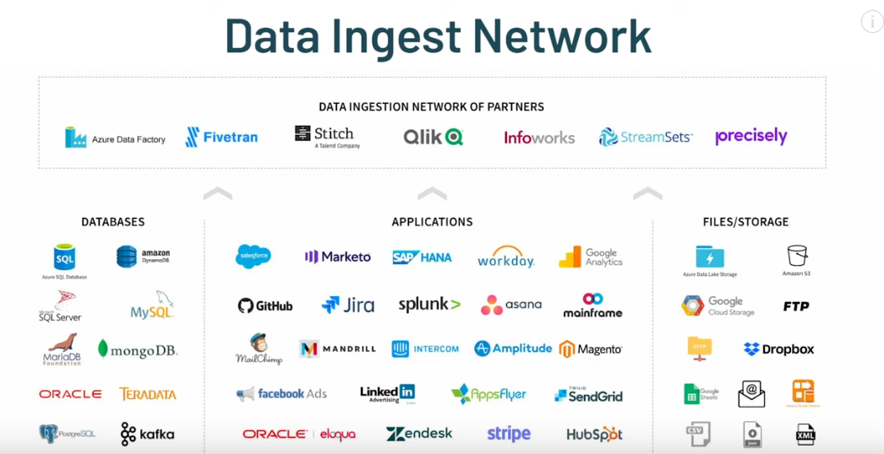

Slide 55
Streaming table
A streaming table is a Delta table with extra support for streaming or incremental data processing. Streaming tables allow you to process a growing dataset, handling each row only once. Because most datasets grow continuously over time, streaming tables are good for most ingestion workloads. Streaming tables are optimal for pipelines that require data freshness and low latency. Streaming tables can also be useful for massive scale transformations, as results can be incrementally calculated as new data arrives, keeping results up to date without needing to fully recompute all source data with each update. Streaming tables are designed for data sources that are append-only.

Slide 56
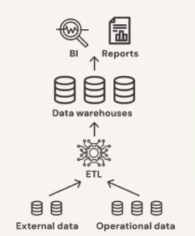
Data Warehouse
It stores structured data
Has predefined schemas
Possible to create BI reports
No support to semi structured data
As data grew in variety, velocity and volume costly to store and delay processing time

Slide 57
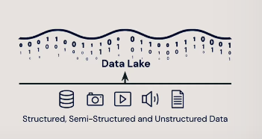
Data Lake
Flexible data storage
Streaming support
Cost efficient
Not supportive to transactional data
Poor data reliability, Data warehouse still needed
Slow analysis and performance
Security and privacy
Lack of ACID transactional support (append execute and merge)
Lack of schema enforcement (immutable)

Slide 58
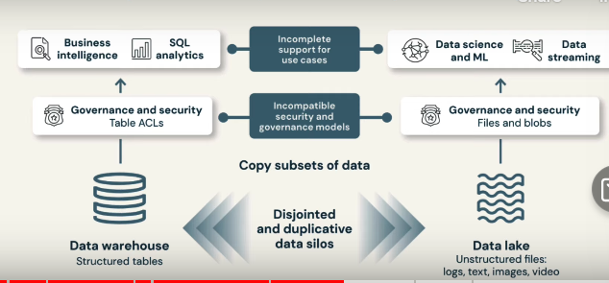

Slide 59

Data Lakehouse

Slide 60


Slide 61


Slide 62

Photon
Next generation query engine

Slide 63


Slide 64
Azure Databricks is an Apache Spark-based analytics platform offered as a fully managed service on Microsoft Azure. It is designed for data engineering, data science, and machine learning tasks, making it a powerful tool for processing and analyzing large volumes of data. Here are key features and components of Azure Databricks:

Slide 65
What is a data pipeline
A data pipeline implements the steps required to move data from source systems, transform that data based on requirements, and store the data in a target system. A data pipeline includes all the processes necessary to turn raw data into prepared data that users can consume. For example, a data pipeline might prepare data so data analysts and data scientists can extract value from the data through analysis and reporting.
An extract, transform, and load (ETL) workflow is a common example of a data pipeline. In ETL processing, data is ingested from source systems and written to a staging area, transformed based on requirements (ensuring data quality, deduplicating records, and so forth), and then written to a target system such as a data warehouse or data lake.

Slide 66
Transactional data
Transactional data typically includes details about events, activities, or operations that involve the exchange of goods, services, money, or information. Here are some common examples of transactional data.
Sales Transactions: Data related to sales, including customer names, product descriptions, quantities sold, prices, and dates of purchase. Sales transaction data is essential for tracking revenue, inventory, and customer preferences.
Financial Transactions: Financial data such as invoices, receipts, payments, and purchase orders. This data is vital for managing cash flow, budgeting, and financial reporting.
Order Transactions: Information about customer orders, including order numbers, shipping addresses, order statuses, and payment methods.
Inventory Transactions: Data about changes in inventory levels, such as stock additions, removals, and adjustments. It helps in managing inventory levels and replenishing stock.
Banking Transactions: Data related to banking activities, including deposits, withdrawals, transfers, and account balances. Banking transaction data is crucial for managing personal or business finances.

